Slide 1

Efficient Solar Panels for Hot Water
Team 21
Stanley Nguyen, Hal Levin, Yuri Zhang, Moises Bensadon
21
Prof Robert Kotiuga

Slide 2
Efficient Solar Panels for Hot Water
21
Prof Robert Kotiuga
Problem to be solved
Solar panels are 15%-22% efficient in optimal conditions and decrease in efficiency as temperature increases
How can circulated water be used to increase efficiency?
Design and build an efficient, low maintenance solar panel hot water heating system

Slide 3
Minimum Viable Product
Our product provides a way to maximize efficiency for photovoltaics and solar water heating by combining the two technologies.
This product will allow existing solar customers to save energy and money as well as provide a cheaper method for new customers to transition to solar power.

Slide 4
Efficient Solar Panels for Hot Water
21
Prof Robert Kotiuga
Who is this for?
Residential customers in very sunny regions where solar panels may overheat thereby reducing efficiency
What do they want?
A way to cool down solar panels.
What is this product?
A water cooled solar panel.
So what?
Not only does our product cool solar panels but it does so by recycling cold water from a heat pump that is already being used to heat water.

Slide 5
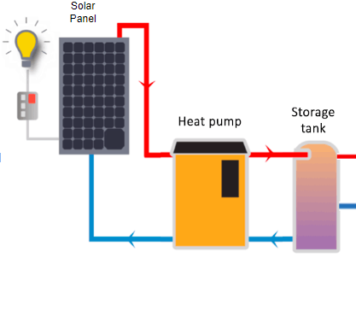
Efficient Solar Panels for Hot Water
21
Prof Robert Kotiuga
System Overview

Slide 6
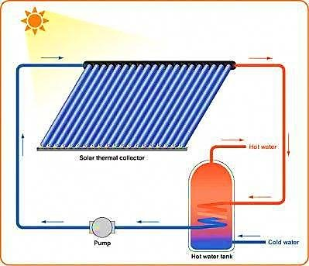
Efficient Solar Panels for Hot Water
21
Prof Robert Kotiuga
System Overview

Slide 7
21
Prof Robert Kotiuga
Competing Technologies / Patents / Other Products
Solar panels solely for water heating
Everything Solar®
RevoluSun®
Hybrid electricity and heat production
DualSun®
Heat exchange patent only in France
There’s a french company that produces a similar technology yet they are not producing on a large scale nor do they have heating capacity for the panels.

Slide 8
21
Prof Robert Kotiuga
Thank you!
Questions/Comments?

